Slide 1
COVID-19 Severity Prediction Based on Gene Expression
Emily Buckley, Tucker Cullen, Julia Pasco-Anderson, Zack Thomas
10-11-2020
Notes:
https://www.ncbi.nlm.nih.gov/geo/query/acc.cgi?acc=GSE152075

Slide 2
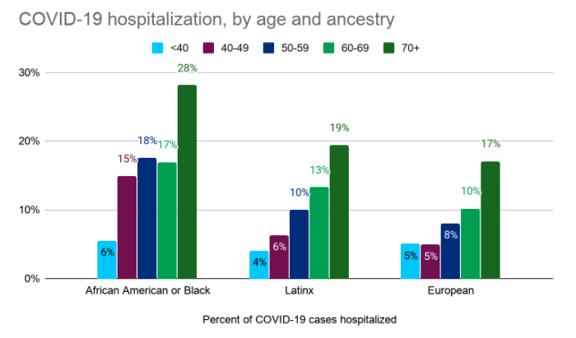
Background on COVID-19
2.81% death rate in the US (Johns Hopkins University, 2020)
Many US citizens do not have access to the care and treatment they need
Numerous factors affect COVID-19 severity, many of which are still unknown
Certain demographics have been hit harder than others
Most likely due to social factors, but genetic variants more commonly found in these groups could play a role (El-Khatib et al, 2020)
Only one drug, remdesivir, has been approved for treatment (National Institute of Health, 2020)
Not beneficial during advanced stages
Notes:
https://www.nytimes.com/2020/09/29/world/europe/sweden-coronavirus-strategy.html
Sweden, with a herd immunity strategy, now has one of the lowest rates of daily new cases in Europe (Erdbrink, October 2020)

Slide 3

Motivation
A need for new therapeutics
Knowledge about gene expression can help guide drug development by identifying possible targets.
Targeted treatment options for COVID-19 are currently very limited
A need for a better understanding of COVID-19 pathophysiology
COVID-19 does not affect everyone equally.
Understanding disease mechanisms can help identify risk groups and guide public health decision making
Notes:
The motivation of this project

Slide 4
Related Work
In vivo antiviral host response to SARS-CoV-2 by viral load, sex, and age (Lieberman et. al)
Identified ACE2 gene as best indicator correlating severity of of viral load
Only looked at differential gene expression, did NOT employ machine learning methods
Upper airway gene expression differentiates COVID-19 from other acute respiratory illnesses and reveals suppression of innate immune responses by SARS-CoV-2 (Mick et al.)
Developed machine learning classifiers to distinguish between COVID-19 and other respiratory diseases
Used combination of LASSO regression and random forest
Developing a COVID-19 mortality risk prediction model when individual-level data are not available (Barda et. al)
Showed it was possible to develop a useful risk predictor without individual-level data
Predictions based on age and sex
Côté, Ternacle, & Pibarot

Slide 5


Our goal is to use machine learning methods to identify the genes implicated in the body’s response to COVID-19.
Notes:
Here, we make the claim of this project.

Slide 6
Data Summary
430 COVID-19 positive individuals
54 COVID-19 negative controls
PCR test results for all positive patients
In the form of cycle threshold (Ct) values
Used to determine viral load
Patient ID | Raw Gene Counts |  |  |  |  |  |  | Ct | Viral Load
 | A1BG | ABL2 | ACE2 | ACYP1 | ADAD1 | ACTR1 | ...
POS_001 | 0 | 0 | 88 | 3 | 9 | 1 | ... | 24.18 | Low
POS_002 | 0 | 3 | 6 | 15 | 12 | 0 | ... | 21.12 | Medium
POS_003 | 0 | 4 | 70 | 3 | 2 | 1 | ... | 18.09 | High
NEG_001 | 0 | 0 | 0 | 0 | 2 | 1 | ... | n/a | Neg
... | ... | ... | ... | ... | ... | ... | ... |  | ...
Notes:
+ simulated?
+ real world datasets?
+ reflecting enough coverage of possible data cases your method targets?
(they should be enough to show/reflect the m contributions you had above!)

Slide 7
Proposed Solution
Preprocess the Data
Label each sample with severity class based on Ct value
Normalize the data
Apply Principal Component Analysis (PCA)
Reduce dimensionality
Determine which genes contribute most to the variance in the first few PCs
Visualize using t-SNE and UMAP
Apply LASSO and Linear Regression
See how well viral load can be modeled
Identify important genes by examining the LASSO coefficients (feature selection)
Test Severity Classification Accuracy of SVC and Logistic Regression
Notes:
Here is our proposed solution.

Slide 8
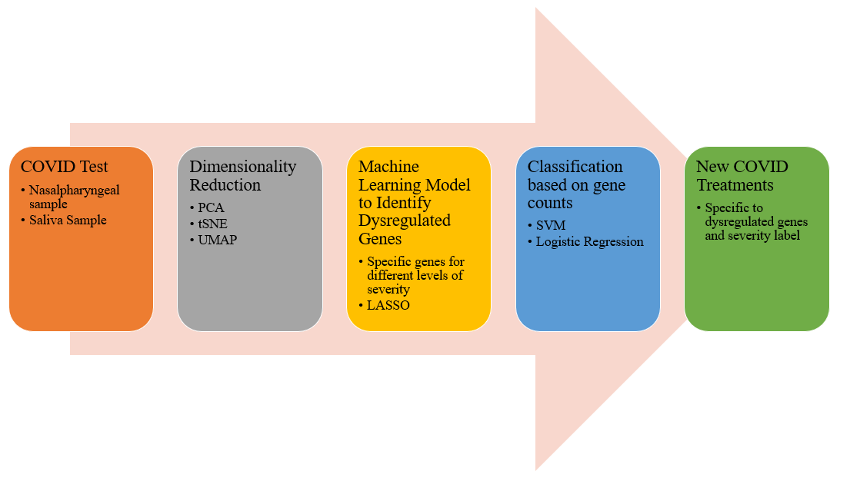
Workflow
Workflow for determining dysregulated genes. First a COVID test will be performed. Next the gene count data will be reduced and put through a well-trained model to predict severity. Finally appropriate treatment will be determined based on the results.

Slide 9
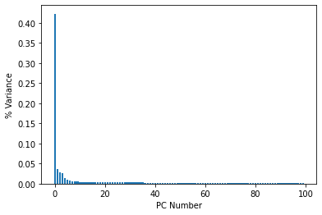
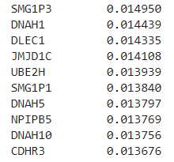
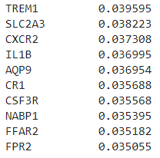
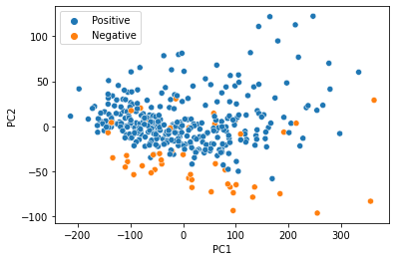
Principal Component Analysis (PCA)
Dimensionality reduction
Ideal for large datasets (35786 genes)
Identified first 100 features as accounting for 77% variance
PC1
PC2
Most Significant Loadings

Slide 10
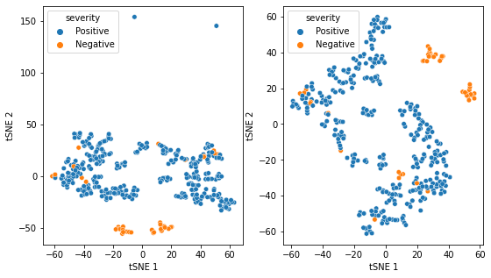
tSNE - positive vs. negative clustering
Many different parameters including perplexity and distance metrics were tested, these two provided the clearest clustering
Cosine Distance Metric
Correlation Distance Metric

Slide 11
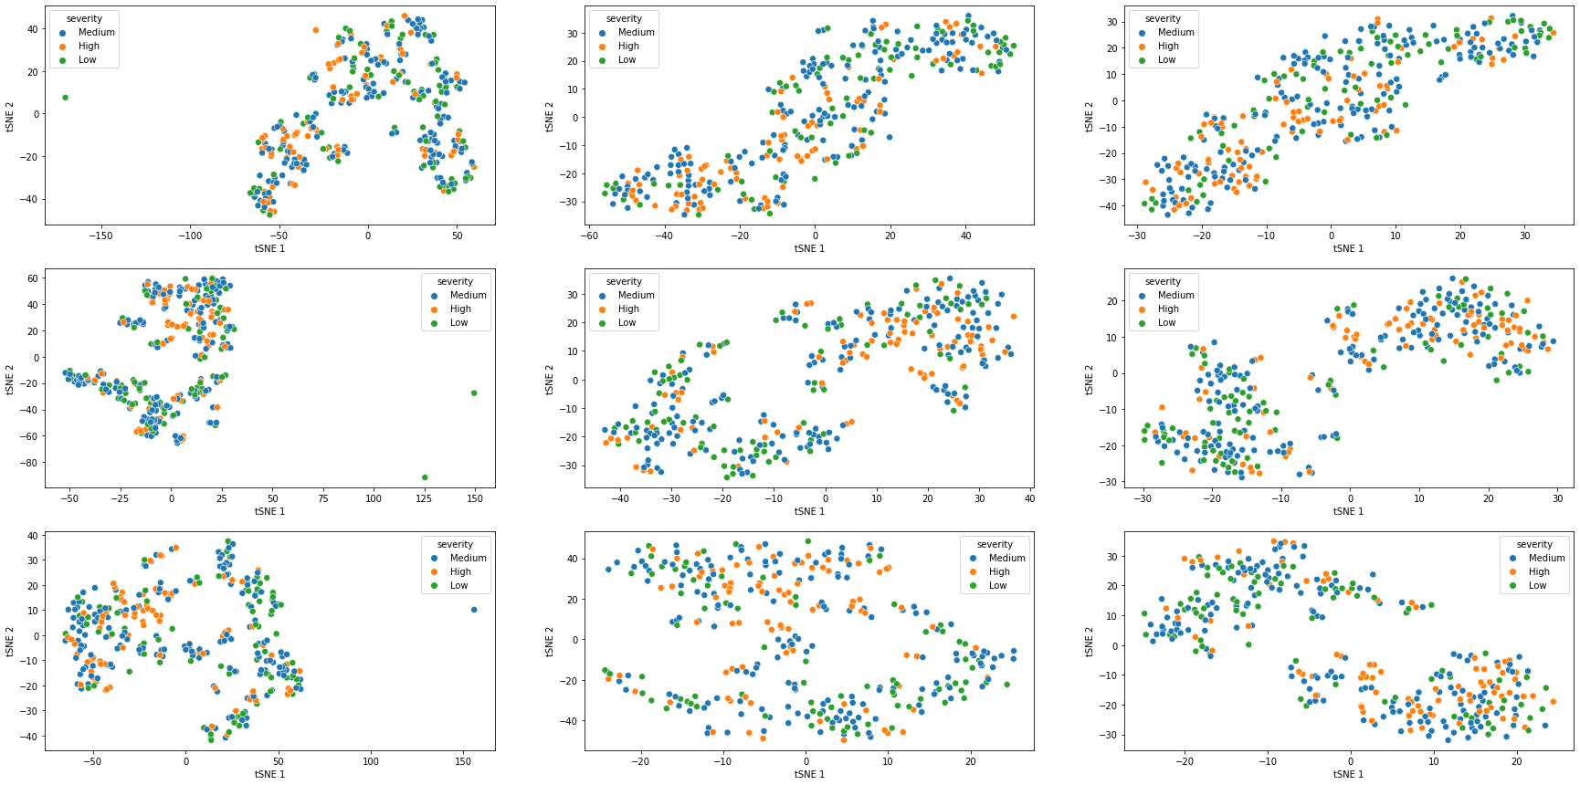
tSNE - severity clustering
Many different parameters including perplexity and distance metrics were tested, however, none resulted in clear clustering

Slide 12
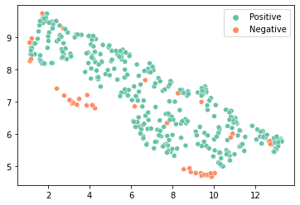
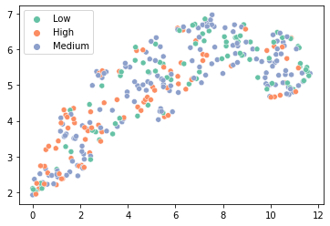
UMAP
Much like tSNE, UMAP clusters +/- fairly well but gives no distinct clusters when looking at severity

Slide 13
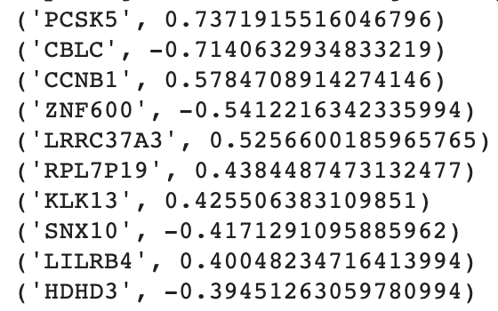
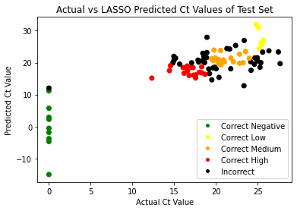
LASSO Regression and Feature Selection
Performs feature selection and L1 regularization to enhance regression accuracy
Coefficients (beta values) of unimportant features (genes) are reduced to zero
Most important genes in the model have largest magnitude coefficients
Our LASSO implementation had R² = 0.623
Gene with the largest coefficient was PCSK5
linked to COVID-19 in other studies as well (Muus et al., Mick et al.)
However, LASSO minimized multiple genes known to play a role in COVID-19 (namely ACE2)
Genes with the 10 Largest Coefficients
Notes:
Most important genes for modeling viral load identified by LASSO are shown on the right

Slide 14
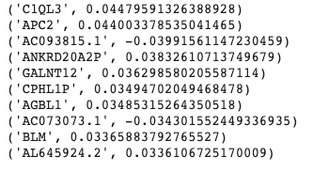
Linear Regression
No regularization step
Not as useful as LASSO for feature selection
Conducted mainly as exploratory step / sanity check
Achieved score of R² = 0.63
Top ten coefficients are shown on the right
No coefficients are eliminated as in LASSO

Slide 15
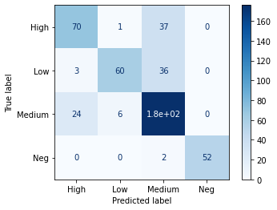
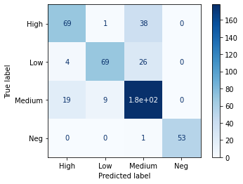
Severity Classifiers
SVC
Logistic Regression
Many hyperparameter sets were tested to obtain the best score
Best Score: 0.62766
Best Params: {'kernel': 'linear', 'C': 0.001, 'degree': 1}
Best Score: 0.65957
Best Params: {'penalty': 'l2', 'C': 0.001, 'solver': 'lbfgs'}
However, this provides little insight into responsible genes and is just used as a check for LASSO and Linear Regression

Slide 16
Technical Challenges/Roadblocks
Extremely high-dimension dataset (35786 genes)
Limited number of samples (484 total, but only 54 negative)
Made even smaller after train-test split
Accuracy of COVID-19 PCR tests is highly variable (reported false negative rate of 21% at best (Kucirka et al.))
Could contribute to low R² and classification accuracy
Attempted elastic-net regression, but struggled to achieve convergence

Slide 17
Contributions
Identified upregulated genes → better understanding of disease mechanism → possible path to treatment
Demonstrated limited success in using machine learning to classify COVID-19 severity based on gene expression.
Notes:
In the rest of this presentation, I’m going to talk about following contents:

Slide 18
LASSO can be used to identify some genes implicated in COVID-19, like PCSK5, through feature selection
But some genes known to be upregulated during COVID-19, like ACE2, were not identified by LASSO -- need for further exploration
SVC and Logistic Regression (after PCA) can be used to classify COVID-19 severity based on gene expression
Conclusion
Test classification accuracy using only the differentially expressed genes identified in the Lieberman et al. paper
Test classification accuracy using only a subset of genes identified through initial LASSO feature selection
Use the same strategy on gene expression for other diseases
Future Work

Slide 19
References
El-Khatib, Z., Jacobs, G. B., Ikomey, G. M., & Neogi, U. (2020). The disproportionate effect of COVID-19 mortality on ethnic minorities: Genetics or health inequalities?. EClinicalMedicine, 23, 100430. https://doi.org/10.1016/j.eclinm.2020.100430
Home. (n.d.). Johns Hopkins Coronavirus Resource Center. Retrieved October 11, 2020, from https://coronavirus.jhu.edu/
Lieberman, N. A. P., Peddu, V., Xie, H., Shrestha, L., Huang, M.-L., Mears, M. C., Cajimat, M. N., Bente, D. A., Shi, P.-Y., Bovier, F., Roychoudhury, P., Jerome, K. R., Moscona, A., Porotto, M., & Greninger, A. L. (2020). In vivo antiviral host transcriptional response to SARS-CoV-2 by viral load, sex, and age. PLOS Biology, 18(9), e3000849. https://doi.org/10.1371/journal.pbio.3000849
Xiao, L., Zhang, W.-F., Gong, M., Zhang, Y., Chen, L., Zhu, H., Hu, C., Kang, P., Liu, L., & Zhu, H. (2020). Development and validation of the HNC-LL score for predicting the severity of coronavirus disease 2019. EBioMedicine, 57, 102880. https://doi.org/10.1016/j.ebiom.2020.102880
Barda, N., Riesel, D., Akriv, A., Levy, J., Finkel, U., Yona, G., Greenfeld, D., Sheiba, S., Somer, J., Bachmat, E., Rothblum, G. N., Shalit, U., Netzer, D., Balicer, R., & Dagan, N. (2020). Developing a COVID-19 mortality risk prediction model when individual-level data are not available. Nature Communications, 11(1), 4439. https://doi.org/10.1038/s41467-020-18297-9
Côté, A., Ternacle, J., & Pibarot, P. (2020). Early prediction of the risk of severe coronavirus disease 2019: A key step in therapeutic decision making. EBioMedicine, 59. https://doi.org/10.1016/j.ebiom.2020.102948
Erdbrink, T. (2020, October 8). Vilified Early Over Lax Virus Strategy, Sweden Seems to Have Scourge Controlled. The New York Times. https://www.nytimes.com/2020/09/29/world/europe/sweden-coronavirus-strategy.html
Therapeutic Management. (2020, December 3). COVID-19 Treatment Guidelines. Retrieved December 6, 2020, from https://www.covid19treatmentguidelines.nih.gov/therapeutic-management/
Mick, E., Kamm, J., Pisco, A. O., Ratnasiri, K., Babik, J. M., Calfee, C. S., Castañeda, G., DeRisi, J. L., Detweiler, A. M., Hao, S., Kangelaris, K. N., Kumar, G. R., Li, L. M., Mann, S. A., Neff, N., Prasad, P. A., Serpa, P. H., Shah, S. J., Spottiswoode, N., … Langelier, C. (2020). Upper airway gene expression differentiates COVID-19 from other acute respiratory illnesses and reveals suppression of innate immune responses by SARS-CoV-2. MedRxiv. https://doi.org/10.1101/2020.05.18.20105171
Muus, C., Luecken, M. D., Eraslan, G., Waghray, A., Heimberg, G., Sikkema, L., Kobayashi, Y., Vaishnav, E. D., Subramanian, A., Smilie, C., Jagadeesh, K., Duong, E. T., Fiskin, E., Triglia, E. T., Ansari, M., Cai, P., Lin, B., Buchanan, J., Chen, S., … The NHLBI LungMAP Consortium, and T. H. C. A. L. B. N. (2020). Integrated analyses of single-cell atlases reveal age, gender, and smoking status associations with cell type-specific expression of mediators of SARS-CoV-2 viral entry and highlights inflammatory programs in putative target cells. BioRxiv, 2020.04.19.049254. https://doi.org/10.1101/2020.04.19.049254

